Slide 1

Final project presentation
Python for data analysis
Lucas ENARD – Myriam ESSAFOUI

Slide 2

Summary
Dataset introduction
Dataset exploration and visualization
Modeling
API

Slide 3

DATASET INTRODUCTION

Slide 4
We selected the following dataset [UCI Machine Learning Repository: Estimation of obesity levels based on eating habits and physical condition Data Set] which include data for the estimation of obesity levels in individuals from the countries of Mexico, Peru and Colombia, based on their eating habits and physical condition.
The first thing we did was to try and understand the content of the dataset, the records are labeled with the class variable NObesity (Obesity Level), that allows classification of the data using the values of Insufficient Weight, Normal Weight, Overweight Level I, Overweight Level II, Obesity Type I, Obesity Type II and Obesity Type III.

Slide 5
Dataset origin and content
It is to be noted that 77% of the data was generated synthetically using the Weka tool and the SMOTE filter, 23% of the data was collected directly from users through a web platform.
The data content is as follow :
• Frequent consumption of high caloric food (FAVC)
• Frequency of consumption of vegetables (FCVC)
• Number of main meals (NCP)
• Consumption of food between meals (CAEC)
• Consumption of water daily (CH20)
• Consumption of alcohol (CALC)
• Calories consumption monitoring (SCC)
• Physical activity frequency (FAF)
• Time using technology devices(TUE)
• Transportation used (MTRANS)
• Other variables obtained were: Gender, Age,Height andWeight.

Slide 6

DATASET EXPLORATION & VISUALISATION

Slide 7
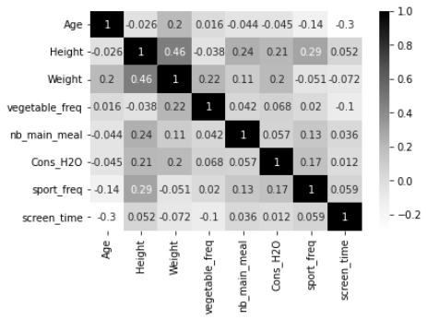
After seeing the dataset, we decided to visualize it by creating a heatmap of the different variables.
The heatmap shows us the high degree of relationship between the height and weight, which is indeed logical, but also the relationship between the sport frequence and height of individuals.
We also observe a high relationship between the height and the number of main meal.
Heat map

Slide 8
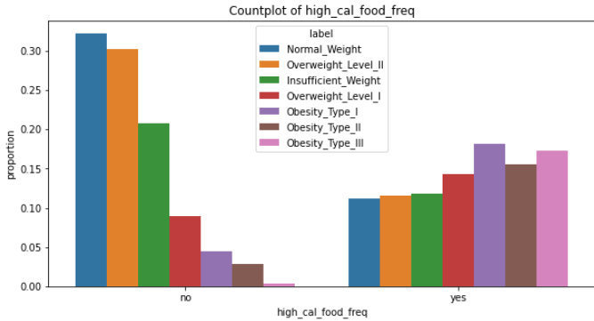
We also plotted, for each variables, a bar plot of the percentage of NObesity
For this example, we are not surprised to see that people who don’t have habits of eating high calories food are basically the normal-weighted, overweighted and insufficient weighted people.
Something interesting is the highest rate of overweighted people of level 1 who have habits of eating high calories food compared to the level 2’s one, while they are less overweight.
Example of a bar plot that can be found in the code

Slide 9
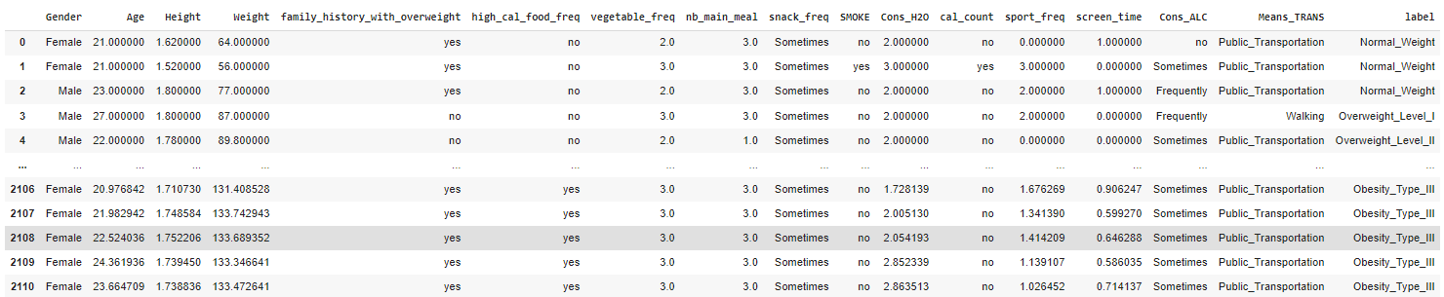
Modification of the columns' names
We first decided to change the columns names in order to have a more practical way of seeing the data in python using Pandas.​

Slide 10
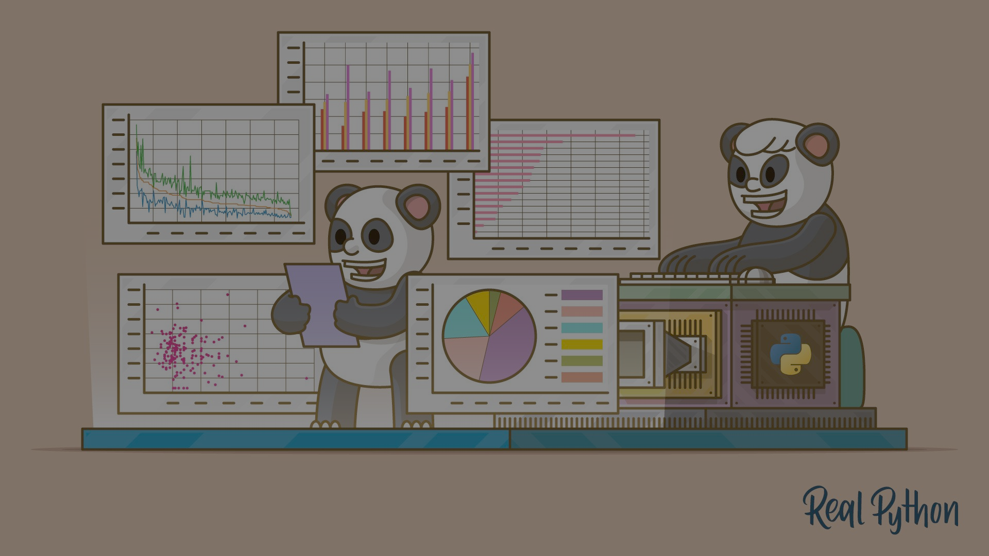
Modeling with all the columns

Slide 11
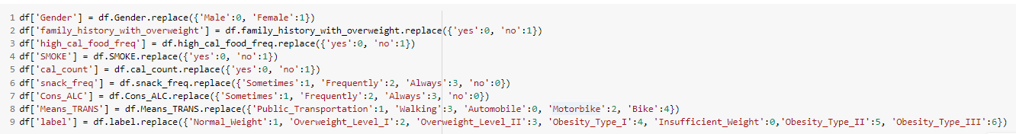
The first thing we had to do was to encode the qualitative data.
We decided to go for an encoding that replaced string value by numeric values.
This method doesn’t lose any information since there was already an order in the data.
for instance, the frequencies would be no : 0, sometimes : 1 ,frequently : 2 and always : 3.

Slide 12
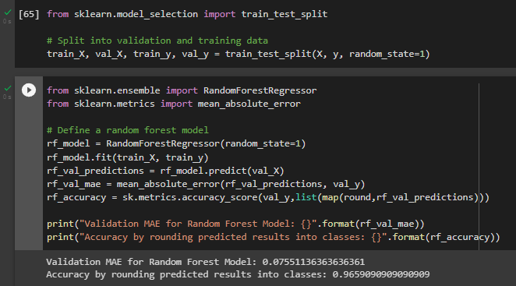
At first, the model seemed obvious, we would just predict the label ( Nobesity ) using all the columns.
However, we quickly saw that predicting the BMI using the height and the weight of the subject was of course not that hard and machine learning wasn’t needed for that.
Here we can see that a simple random forest without neither grid search nor further modification gives really decent results with a really good MAE and accuracy

Slide 13
Modeling Predicting the BMI (label) of a subject using only his habits and practices

Slide 14
This is where our real problematic comes from:
Can we predict the BMI (label) of a subject using only his habits and practices?
The next step was to get rid of the weight and the height to then try different algorithms and pick one.

Slide 15
We chose five algorithms to try and predict the class (label) of each individuals.
-Random forest
-Decision Tree Classifier
-Knn
-SGD
-Logistic regression
There were seven different labels as seen earlier and we decided to measure the performance to show the accuracy of the model but also the MEA (mean absolute error).
The MEA allows use to understand if the models are only a little wrong, which means predicting high obesity type 1 instead of type 2 or if it predicts underweight in an obesity type 2 situation

Slide 16
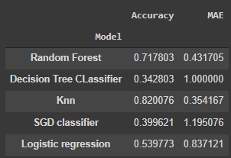
It was clear that the Knn algorithm was the best performing one
Accuracy and MAE(mean absolute error) for 5 different models

Slide 17
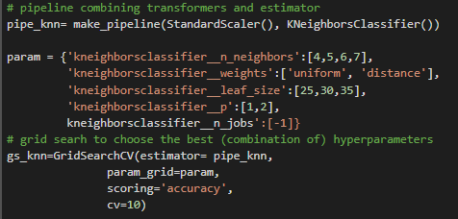
Because we decided to explore the Knn algorithms for our problem it was time to do a Grid Search in order to have the best knn possible.
Grid Search on the knn parameters

Slide 18
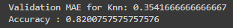
At the end we get an amazing accuracy of 0.82 and a MAE of 0.354

Slide 19
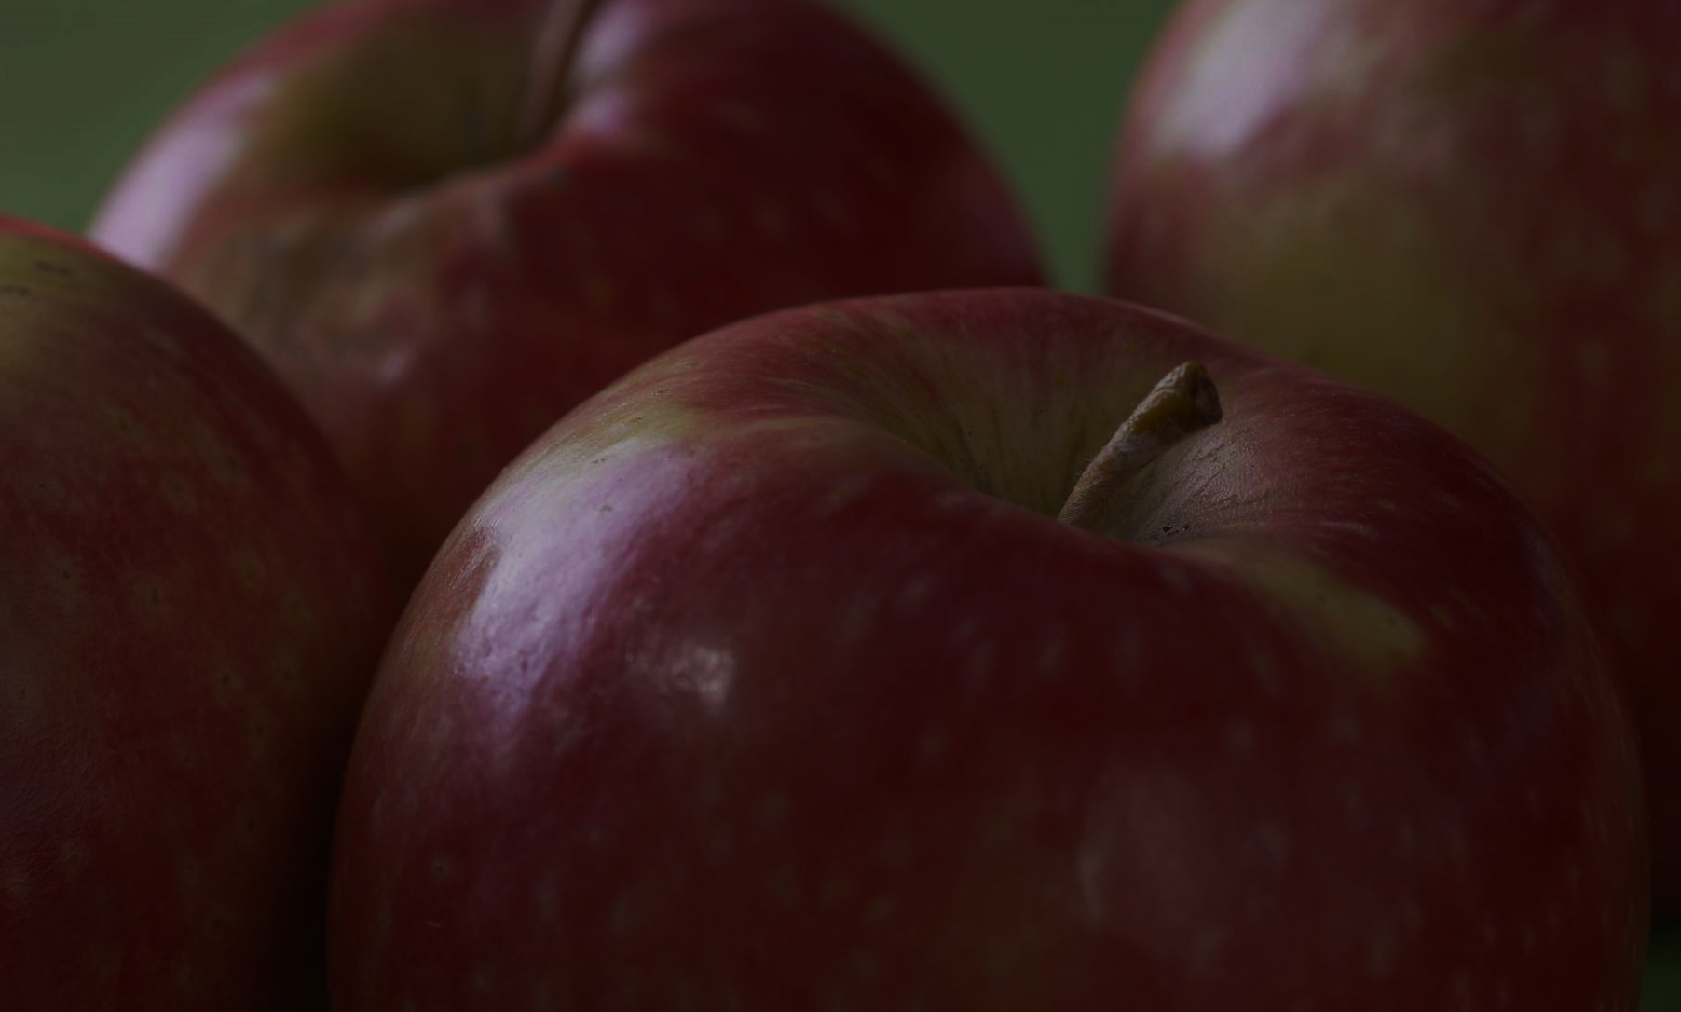
CONCLUSION
We saw that 82% of the predictions were correct based only on the habits, and physical condition and even on the family history !
Surprisingly, these factors have a significant impact on the chances of developing obesity.
To avoid and limit the probability of being affected, we should take care of our health, our eating and drinking habits, because like many chronic conditions, obesity is preventable with a healthy lifestyle : staying active, following a healthy diet, and so on.

